Slide 1

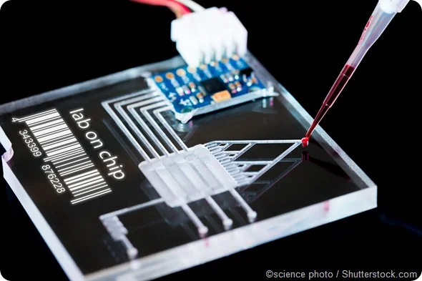

Interdigitated Electrodes in Microfluidics
Erin Ingram & Omar Mahmood
Dr. Arum Han, Dr. Han Zhang
NanoBio Systems Lab
Notes:
Erin

Slide 2
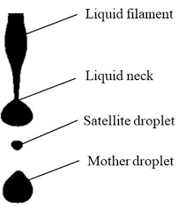
Problem Statement
Satellite droplets form during droplet generation
Negatively affect the manipulation of desired droplets
Cross contamination
False test results
Notes:
Omar

Slide 3
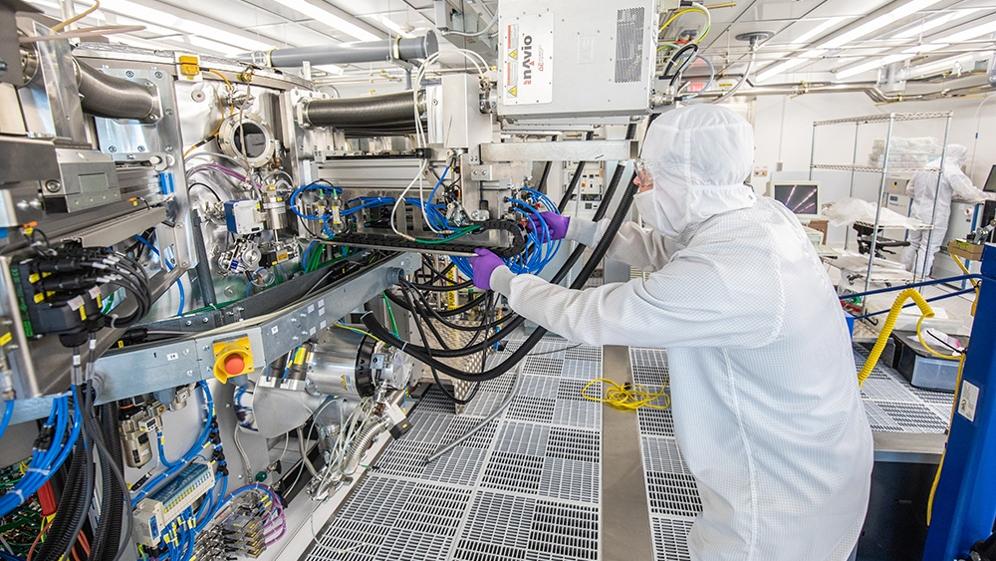
Our solution
Electrodes
Design a two stage filtration system incorporating an Interdigitated Electrode (IDE) arrays to perform size based filtration and prevent satellite droplets from making it to the chip’s output
Fabricate entire device in AggieFab – nano/micro fabrication facility
Fluid flow
Notes:
Erin

Slide 4
Subsystem Updates

Slide 5
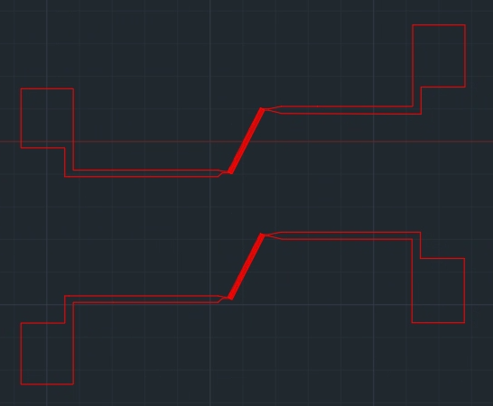

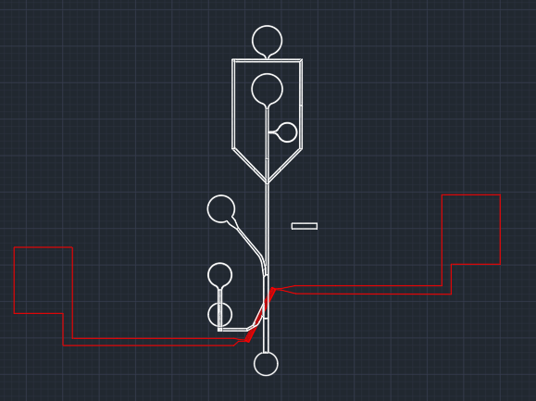
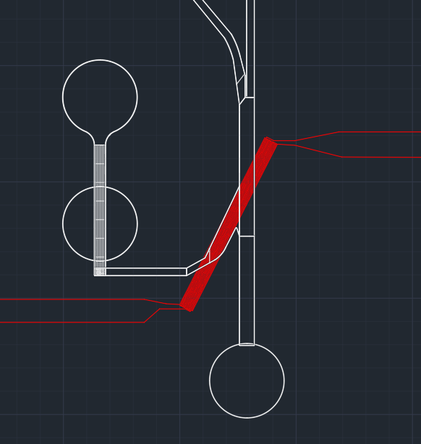
Overall design
+
=
Notes:
Erin

Slide 6
Subsystems and Interface
Satellite droplet
Channel - Fabricated by Omar
IDE- Fabricated by Omar
Droplet
PCR
Desired droplets
Satellite droplets - “waste”
Channel - Fabricated by Erin
IDE - Fabricated by Erin
Various droplet sizes
1
2
1- Droplets not big enough - “Waste”
2- Droplets too big - “Waste”
3- Perfect size
3
Final Droplets
Notes:
Both

Slide 7
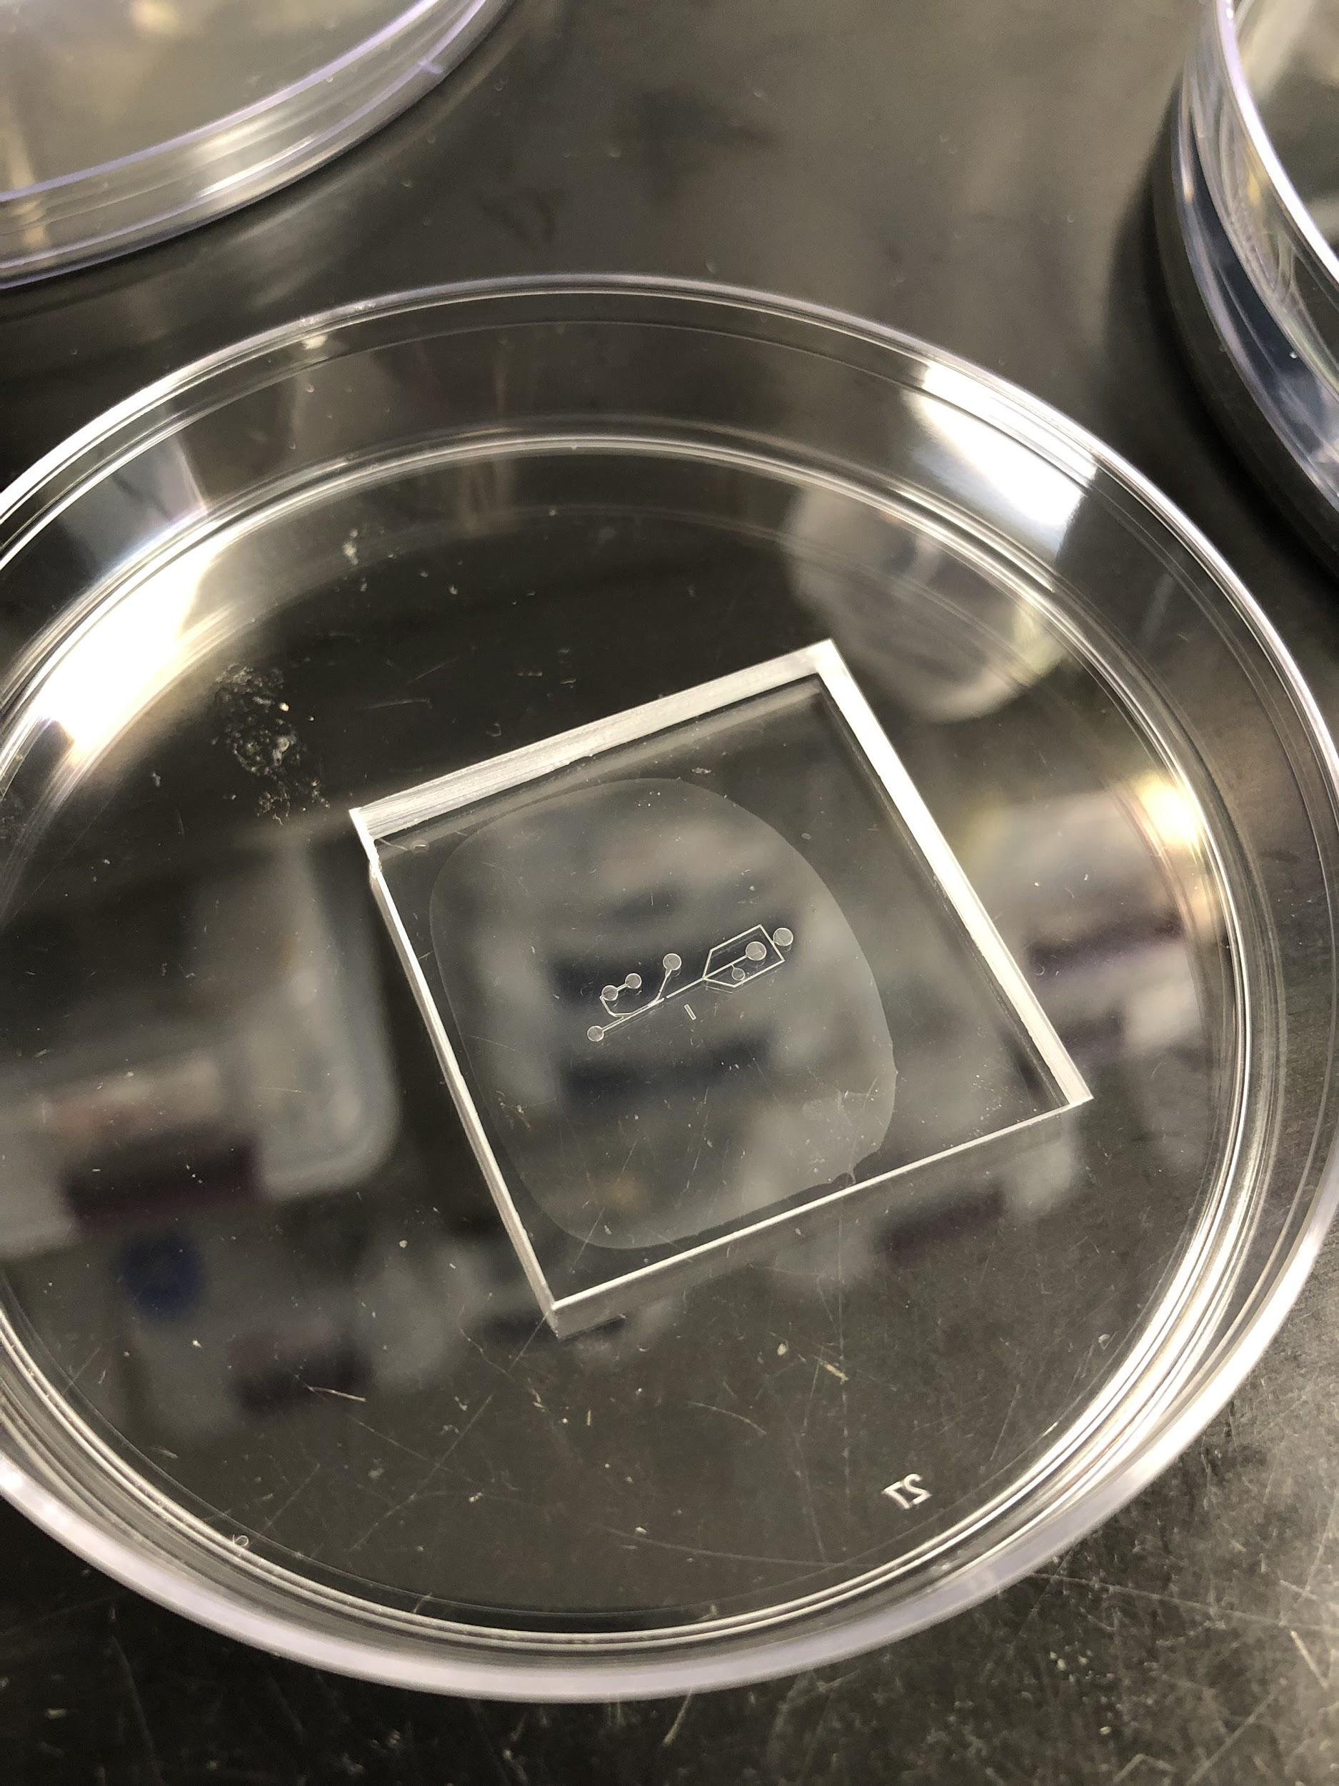
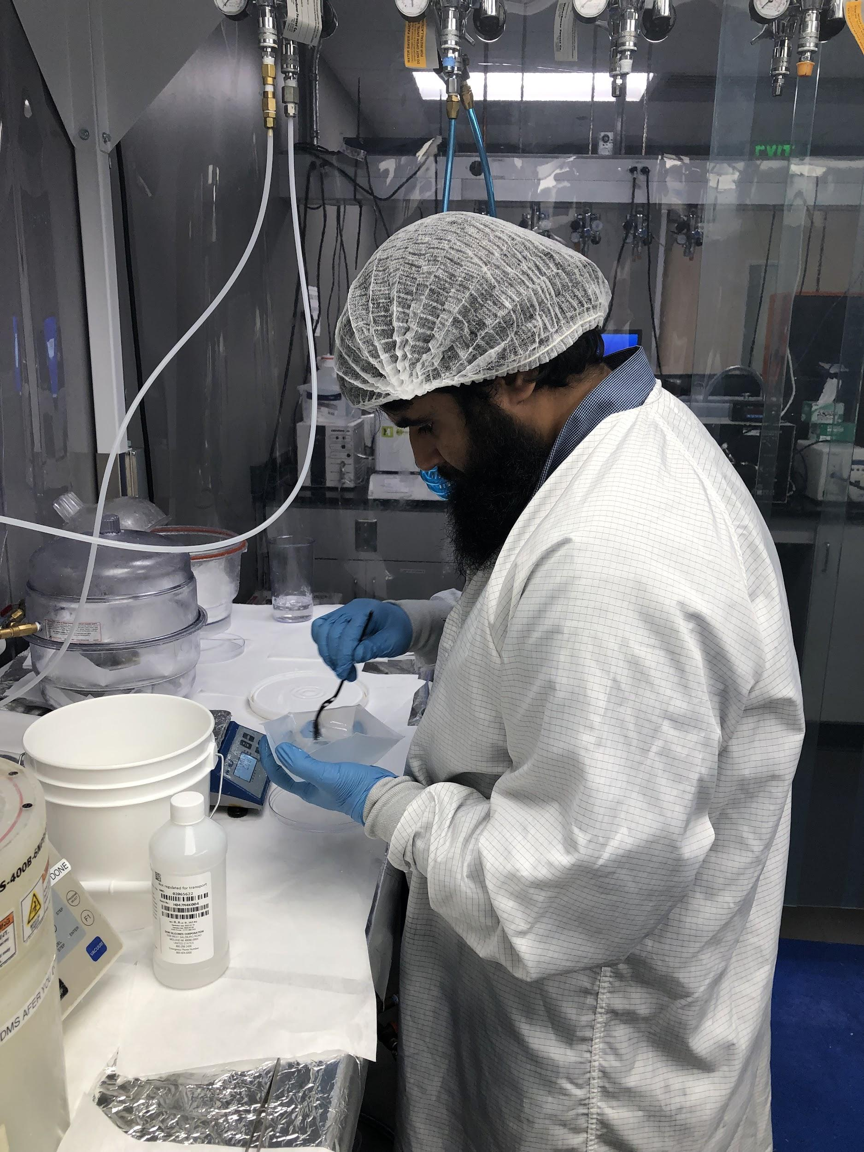
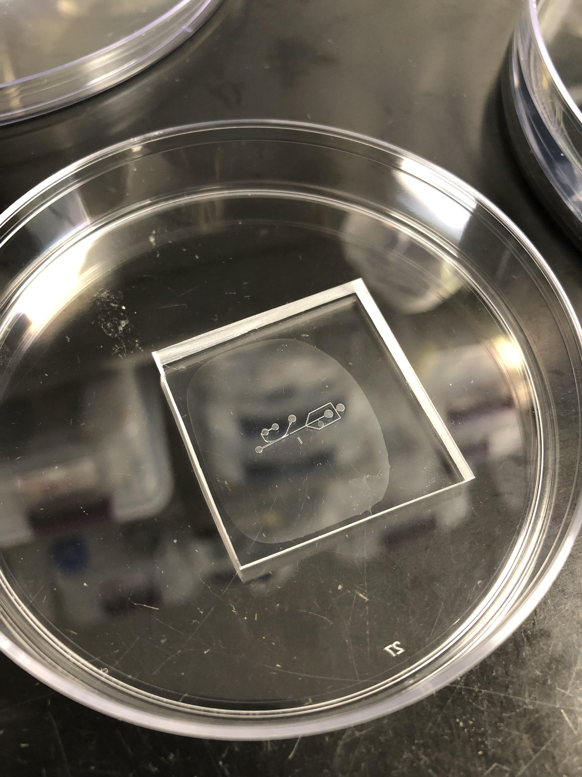
High Pass Filter - Omar
Progress:
3D printed master mold using Nanoscribe
Troubleshot printing error
Fabricated channel copies via softlithography
Validating Stage 1
Notes:
Omar

Slide 8
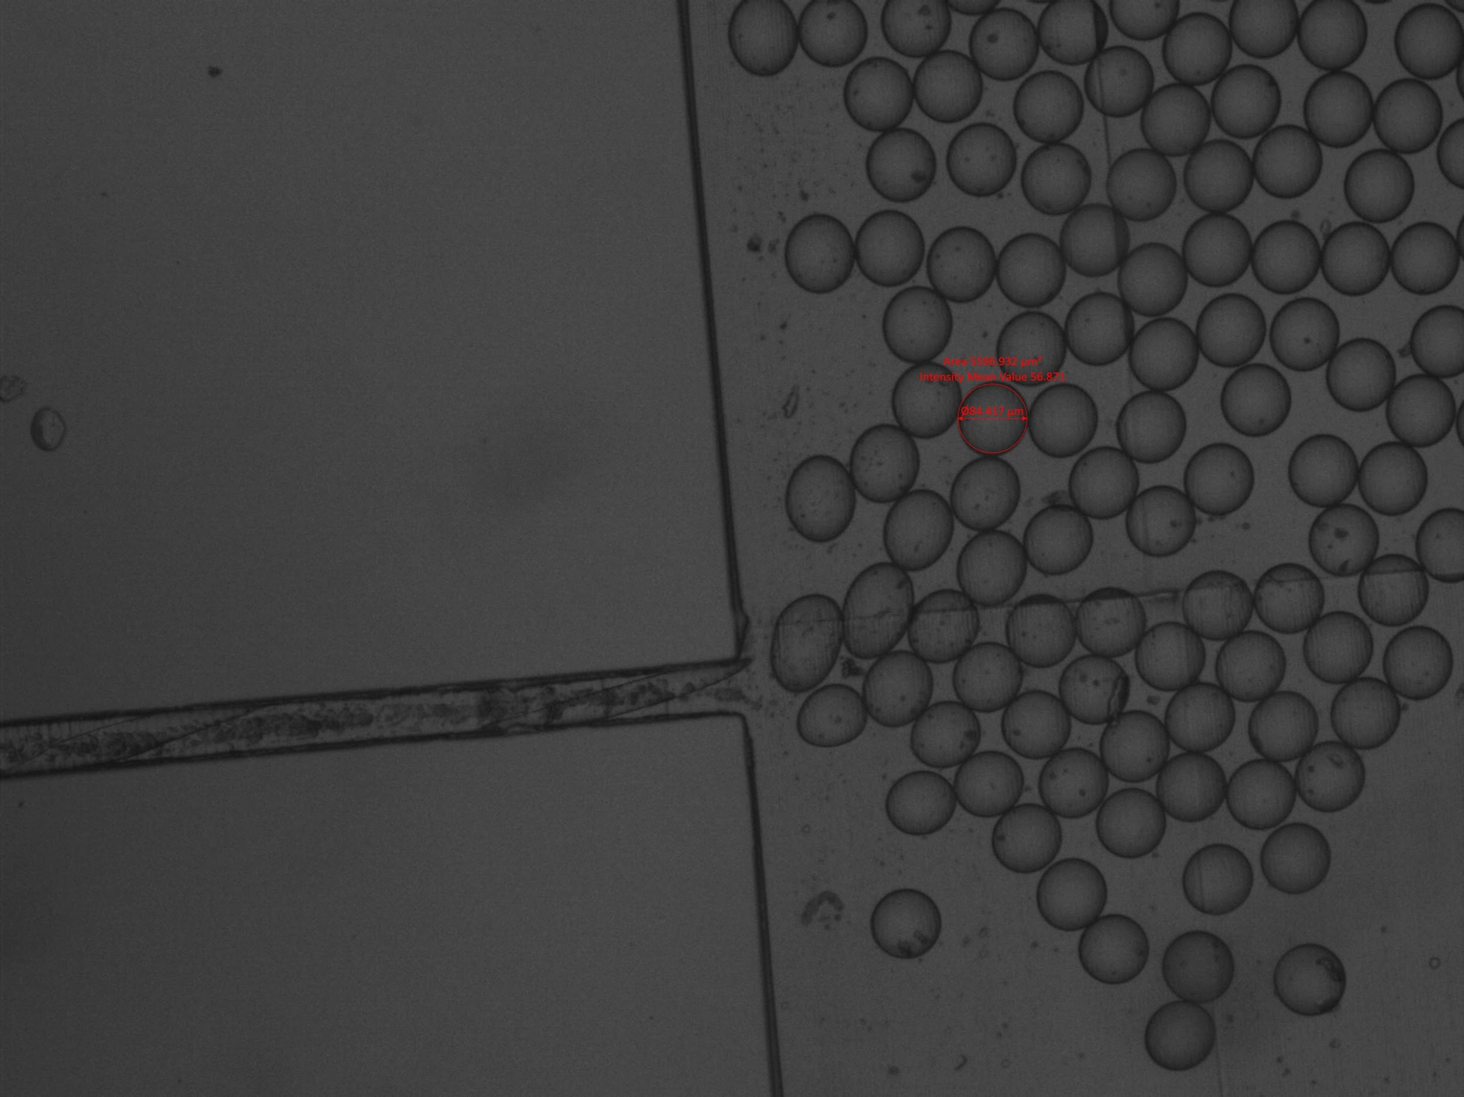
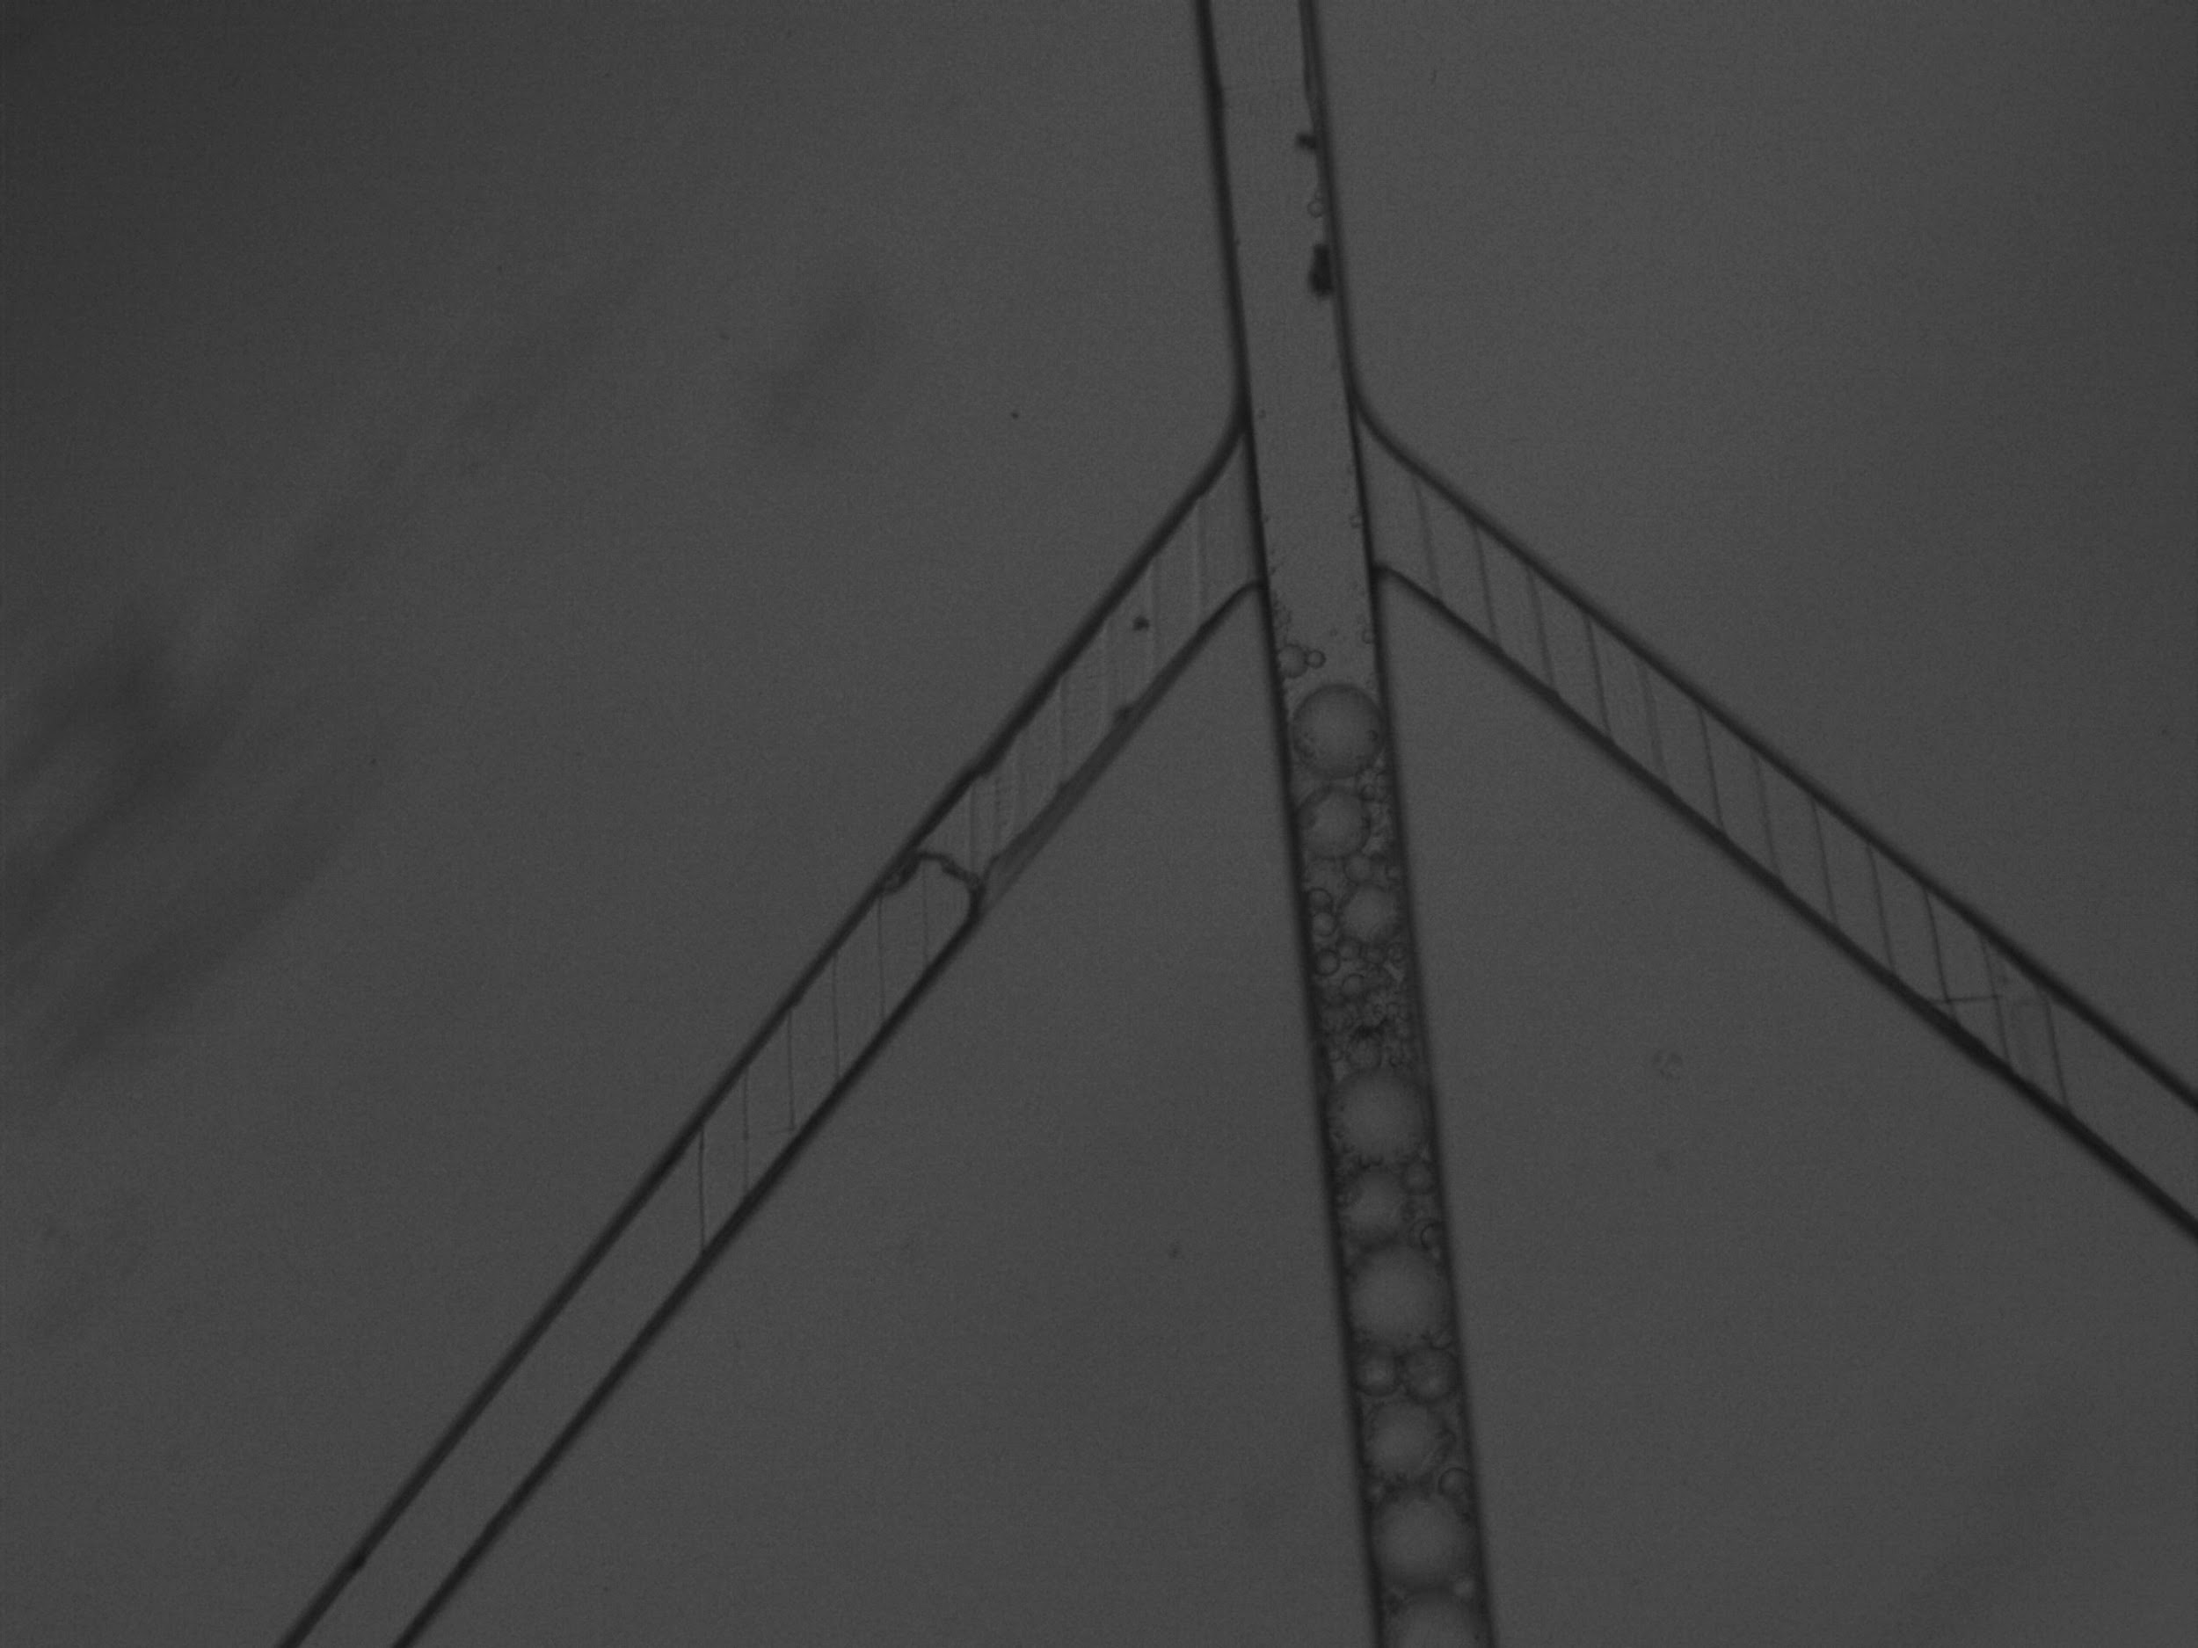
Stage 1 Validation
Generated 85 µm droplets using a specialized generator
Droplets passed through channel successfully
Testing print quality
No leakages or clogs
Next step: validating Omar’s droplet generator
Notes:
Omar

Slide 9
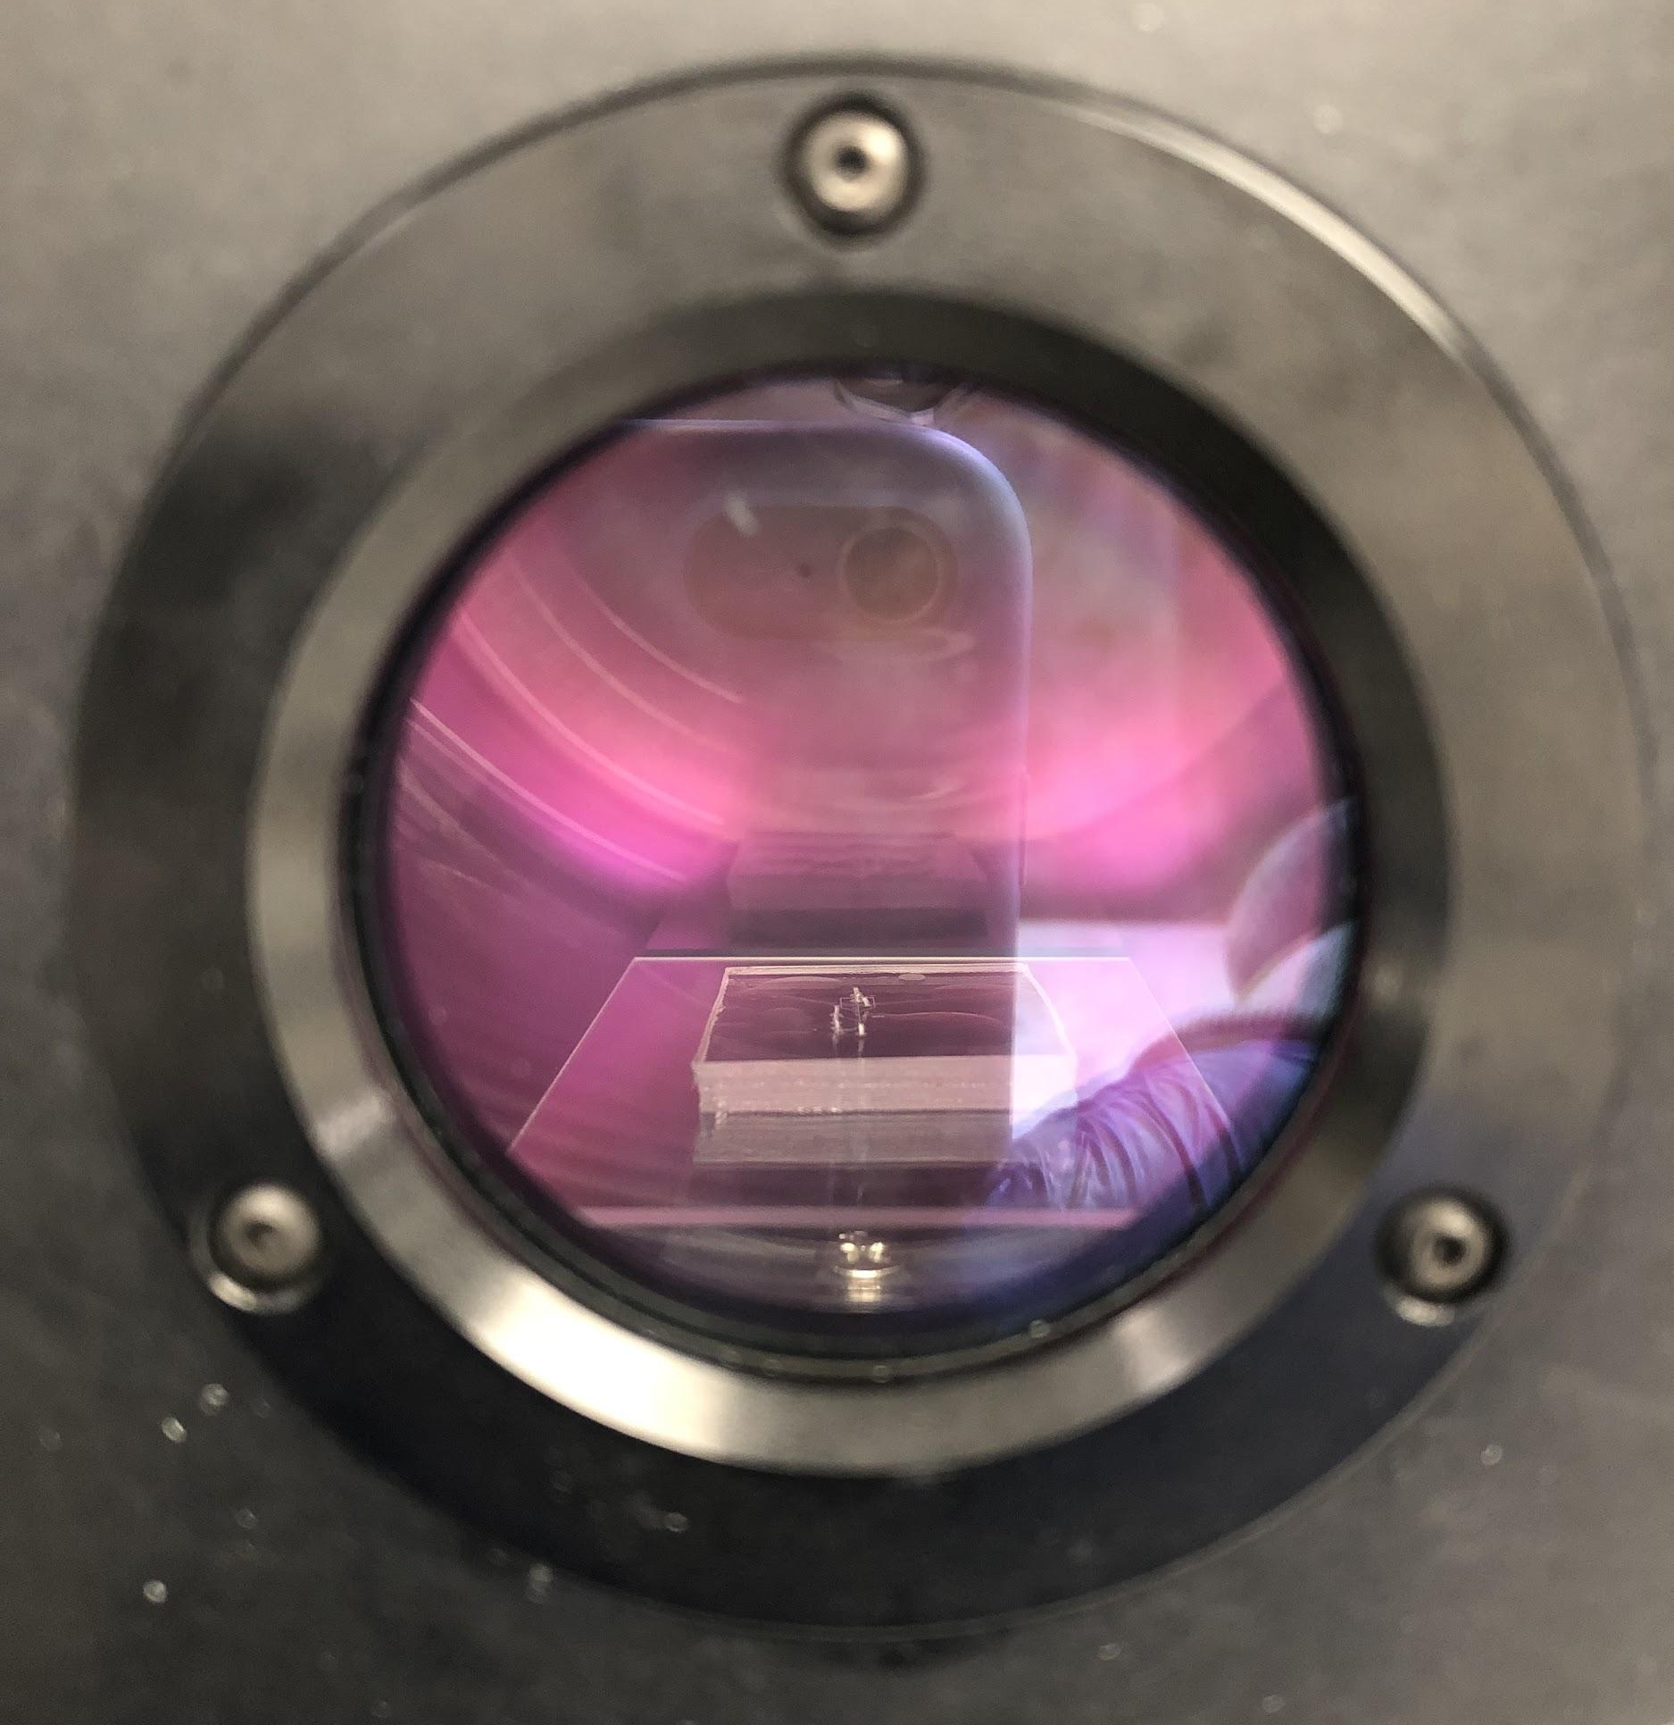
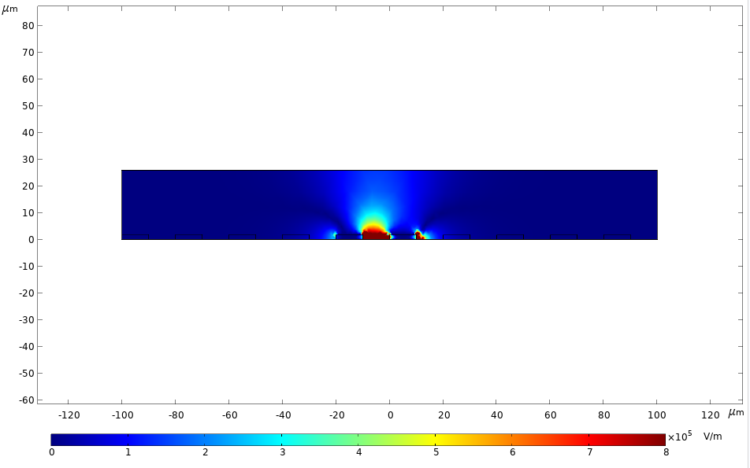
Band Pass Filter - Erin
Progress:
Printing master mold – Nanoscribe under repair
COMSOL - electric field simulations
Plasma bonding
Troubleshooting
Out of oxygen
Trained Omar
Microscope training
Next steps: print master mold, softlithography, validate channel quality
Notes:
Erin

Slide 10
Execution Plan
 | 9/16/22 | 9/30/22 | 10/14/22 | 10/28/22 | 11/11/22 | 11/25/22
High Pass Filter (Omar) | Train on non-cleanroom related tasks: -Soft-lithography -Plasma cleaner -Microscopes -PCR techniques | Design the channel, fabricate master mold using NanoScribe | Design IDEs Fabricate softlithography copies of channel | Finish droplet generation validation of Stage 1 Plasma bonding Train on metal deposition, photolithography, wet etching | COMSOL simulations complete Perform experiments using the bonded device, experiment with different IDE characteristics | Validate high pass filtration using ideal IDE parameters
Band Pass Filter (Erin) | Train on non-cleanroom related tasks: -Soft-lithography -Plasma cleaner -Microscopes -PCR techniques | Design the channel, fabricate master mold using NanoScribe (UPDATE: on hold) | Design IDEs Plasma bonding training COMSOL training | Microscope/high speed camera training Train on metal deposition, photolithography, wet etching Plasma bonding Expecting NanoScribe to be fixed, master mold to be printed | COMSOL simulations complete Fabricate softlithography copies of channel Perform experiments using the bonded device, experiment with different IDE characteristics | Validate band pass filtration using ideal IDE parameters
Notes:
Both

Slide 11
Validation Plan
Stage 1 Channel | Stage 2 Channel | High Pass IDE Filter | Band Pass IDE Filter | Finished Device
Print quality Droplet generation | Print quality Droplet generation | Verify electric field strengths Filtration of small droplets | Verify electric field strengths Filtration of small and large droplets | Successful droplet generation and filtration of all droplet sizes in both stages “Successful” = 98% accurate filtration
***Both team members follow the same schedule for their specific subsystem
Notes:
Erin

Slide 12
Thanks! Questions?

